Slide 1

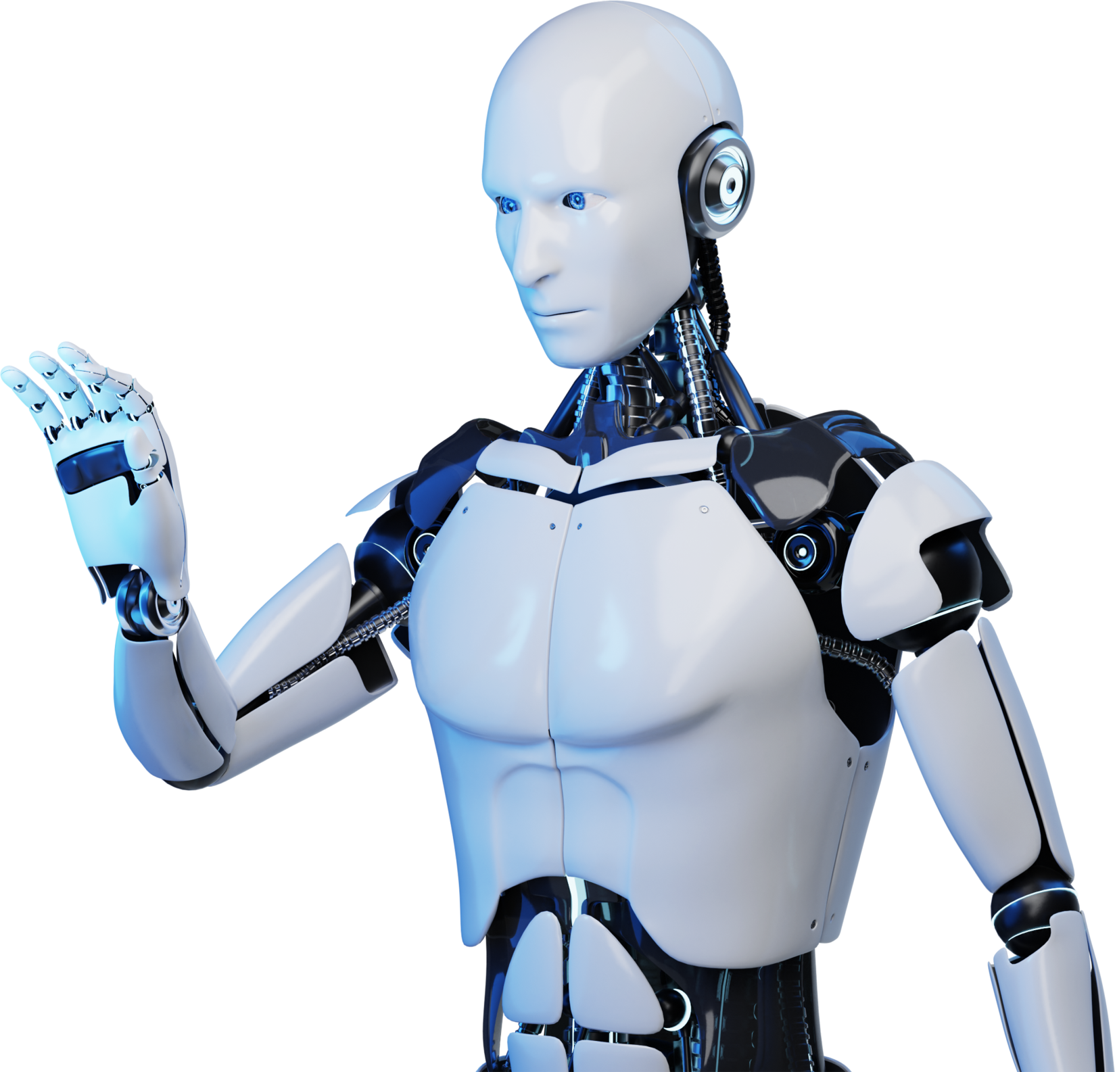
Project Machine Predication Maintenance

Slide 2
Presentation to
Digital Egypt Pioneers Initiative DEPI
Company
AST
Track
Microsoft Machine Learning Engineer
Presented By
Ahmed Nasser Sayed
Ahmed Ashraf Mohammed
Mohammed Sobhy Lotfy
Youssef Salah Ahmed
Youssef Mohsen Poules

Slide 3
Agenda
01. Introduction
02. Project Overview
03. Project Objective
04. Problem Statements
05. Project Tools

Slide 4

Introduction
Traditional maintenance methods, like scheduled or reactive maintenance, result in inefficiency, unplanned downtime, and high costs. Predictive maintenance forecasts equipment failures, enabling timely maintenance to reduce these issues.

Slide 5

Project Overview
Core Components:
Predictive Maintenance System: Uses machine learning to forecast equipment failures, enabling timely maintenance and reducing downtime.
Historical Sensor Data: Leverages past machine sensor data to identify patterns and predict future failures.
Machine Learning Models: Trains models to accurately predict failures using algorithms such as Random Forest, SVM, KNN, Decision Tree, and Naive Bayes.

Slide 6

Project Overview
Technologies:
Programming Language: Python
Libraries: Scikit-learn, Pandas, Imbalanced-learn (SMOTE)
Machine Learning Models: Random Forest, SVM, KNN, Decision Tree, Naive Bayes

Slide 7

Project Objective
The project aims to develop a machine learning-based predictive maintenance system to minimize equipment downtime, reduce maintenance costs, and enhance operational efficiency. Specific goals include

Slide 8
AI Chatbots In
E-commerce
Project Tools:
1- Kaggle: Some of the Dataset
2- Colab: to run the Notebook

Slide 9

Data Description
Dataset: Machine Predictive Maintenance Dataset from Kaggle.
Link: https://www.kaggle.com/datasets/shivamb/machine-predictive-maintenance-classification
Dataset Structure: - Number of Observations: 10,000 samples (rows). - Features: UDI, Product ID, Type, Air Temperature, Process Temperature, Rotational Speed, Torque, Tool Wear. - Target: Machine Failure (binary: Failure or No Failure). - Dataset Issues: Imbalanced Classes.

Slide 10
Data Collection and
Pre-Processing
Objective: Clean and prepare the dataset for modeling. - Handling Missing Values: Missing values handled through median filling or row removal. - Feature Engineering: Interaction terms created, such as temperature differential between internal and external temperatures. - Outlier Detection: Z-scores and IQR method used for outlier removal. - Feature Scaling: Standard Scaler applied for normalization of features. - Handling Imbalanced Data: SMOTE applied for balancing the dataset.

Slide 11
Algorithm Used
Objective: Compare multiple machine learning algorithms for classification. - Support Vector Machine (SVM): Maps data into higher dimensions to find a hyperplane. Best for high-dimensional, non-linear data. - Decision Tree: Simple model splitting data based on feature thresholds. - K-Nearest Neighbors (KNN): Classifies data based on proximity to neighboring points. - Random Forest: An ensemble of decision trees to improve accuracy and reduce Overfitting.

Slide 12
Models
Logistic Regression: is a linear model that is simple and interpretable.
Decision Tree: builds a flowchart-like structure to make decisions based on features.
Random Forest: is an ensemble of decision trees that improves prediction accuracy by reducing overfitting.
Support Vector Machine (SVM): constructs a hyperplane to separate data points into different classes, and it works well with high-dimensional data.

Slide 13
Evaluation Metrics
We define appropriate metrics to assess the performance of our AI models, Such as:
Accuracy
Precision
Recall
F1-Score
These metrics help us quantify the effectiveness of our solutions.

Slide 14
Result and Accuracy
Objective: Present model performance and compare their effectiveness. - Accuracy Scores: Logistic Regression: 0.8877
Decision Tree: 0.9718
Random Forest: 0.9824
Support Vector Machine: 0.9573
Performance Analysis: Random Forest was the most accurate model due to its ensemble nature, which helped capture complex patterns in the data.

Slide 15

Question & Answer
ask any Questions!

Slide 16
Thanks for Your Time
Need your Feedback
Ahmed Nasser Sayed
Ahmed Ashraf Mohammed
Mohammed Sobhy Lotfy
Youssef Salah Ahmed
Youssef Mohsen Poules

